Slide 1

Contents
Continuous Sign Language Recognition
1. Abstract
2. Introduction
3. Literature Survey
4. Software Requirement Specifications
5. Design
6. Implementation
7. Testing and Results
8. Conclusion
9. References

Slide 2
Abstract
Continuous Sign Language Recognition
The system captures real-time hand gestures using MediaPipe and classifies them into alphabets, words, and sentences.Recognized signs are converted into natural multilingual speech for clear communication.Speech input is processed and mapped to sign animations, enabling speech-to-sign translation.This dual-mode framework bridges communication gaps and makes interaction more inclusive and accessible.

Slide 3
Introduction
Continuous Sign Language Recognition
Sign language serves as a vital mode of communication for the deaf and hard-of-hearing community.
Deaf and hard-of-hearing individuals rely on sign language, but most hearing people do not understand it, creating a communication gap.
Advancements in computer vision, deep learning, and NLP now enable intelligent systems that can translate between sign language and speech.
The project provides a real-time assistive platform that converts sign gestures to speech and speech to sign animations.

Slide 4
Literature Survey
Continuous Sign Language Recognition
Sl. No | Title | Author(s) | Year | Short Description
1 | CSLR system using deep learning with mediapipe holistic | Sharvani Shrivastva et al. | 2024 | Developed a Continuous Sign Language Recognition (CSLR) system using MediaPipe Holistic and LSTM. Eliminated the need for external hardware like gloves or sensors.
2 | Speak2Sign3D: Multimodal Pipeline for Speech to 3D Sign Animation | K .M.Rafman et.al | 2025 | Introduces a speech → text → 3D animation pipeline using Whisper and transformer models.
3 | Enhancing Sign Language Detection through MediaPipe and CNNs | A. Kumar et al. | 2024 | Combines MediaPipe landmarks with CNN/RNN classifiers for real-time sign recognition.
4 | Speech-driven Sign Language Avatar Animation System | L. Hu et al. | 2024 | Proposes an end-to-end system converting speech to animated sign avatars with motion generation.
Dept of CSE(DS),SJBIT

Slide 5
Continuous Sign Language Recognition
Sl. No | Title | Author(s) | Year | Short Description
5 | Sign Language Translation: A Survey of Approaches and Datasets | Z. Liang et al. | 2023 | Focuses on translation (not just recognition), glossing, sequence modeling, and dataset limitations.
6 | Sign Language Recognition: A Deep Survey | R. Rastgoo et al. | 2022 | Survey discussing CNN, RNN, and transformer-based SLR approaches and evaluation metrics.
7 | Sign Language Gloss Translation using Deep Learning | S. J. Huang et al. | 2021 | Uses Seq2Seq and attention mechanisms for gloss-to-text and text-to-gloss translation.
8 | Voice-to-Sign Language Translator Using NLP | P. Singh | 2021 | Demonstrates speech-to-text → gloss mapping → animated sign output using NLP.

Slide 6
Motivation
Continuous Sign Language Recognition
Sign language is essential for millions, but low sign-language literacy among hearing individuals creates serious communication barriers in daily life.
These barriers affect education, healthcare, employment, and public services,limiting inclusion and independence for deaf and hard-of-hearing users.
A real-time system that converts sign gestures to speech and speech to sign enables direct two-way communication without needing human interpreters.
Modern tools like MediaPipe, OpenCV, speech recognition, and Flask now make such real-time, deployable assistive solutions practical and accessible.

Slide 7
Objectives
Continuous Sign Language Recognition
Design and implement a MediaPipe + OpenCV pipeline to extract robust hand and pose landmarks in real time.
Implement sentence formation and multilingual Text-to-Speech (TTS) for sign→speech output.
Implement a speech→text→sign animation pipeline that maps recognized speech to sign glosses and animates them .
Deploy the end-to-end application as a Flask web app with user authentication and SQLite3 storage.
Evaluate system accuracy, latency, and user acceptance.

Slide 8
Software Requirements
Continuous Sign Language Recognition
OS: Windows 10+, Ubuntu 20.04+, or macOS.
Python: 3.8 or later.
Flask: A lightweight web framework required to serve the application as a web app
MediaPipe: Provides pre-trained, real-time pipelines for hand and pose landmark detection
OpenCV : Handles video capture, frame preprocessing, image transformations
ML model: SVM (Support Vector Machine)
Speech-to-Text: Java Script Recognition API
Text-to-Speech: gTTS with pygame .
Frontend: HTML5, CSS3, JavaScript.
Database: SQLite3 for session/user data.

Slide 9
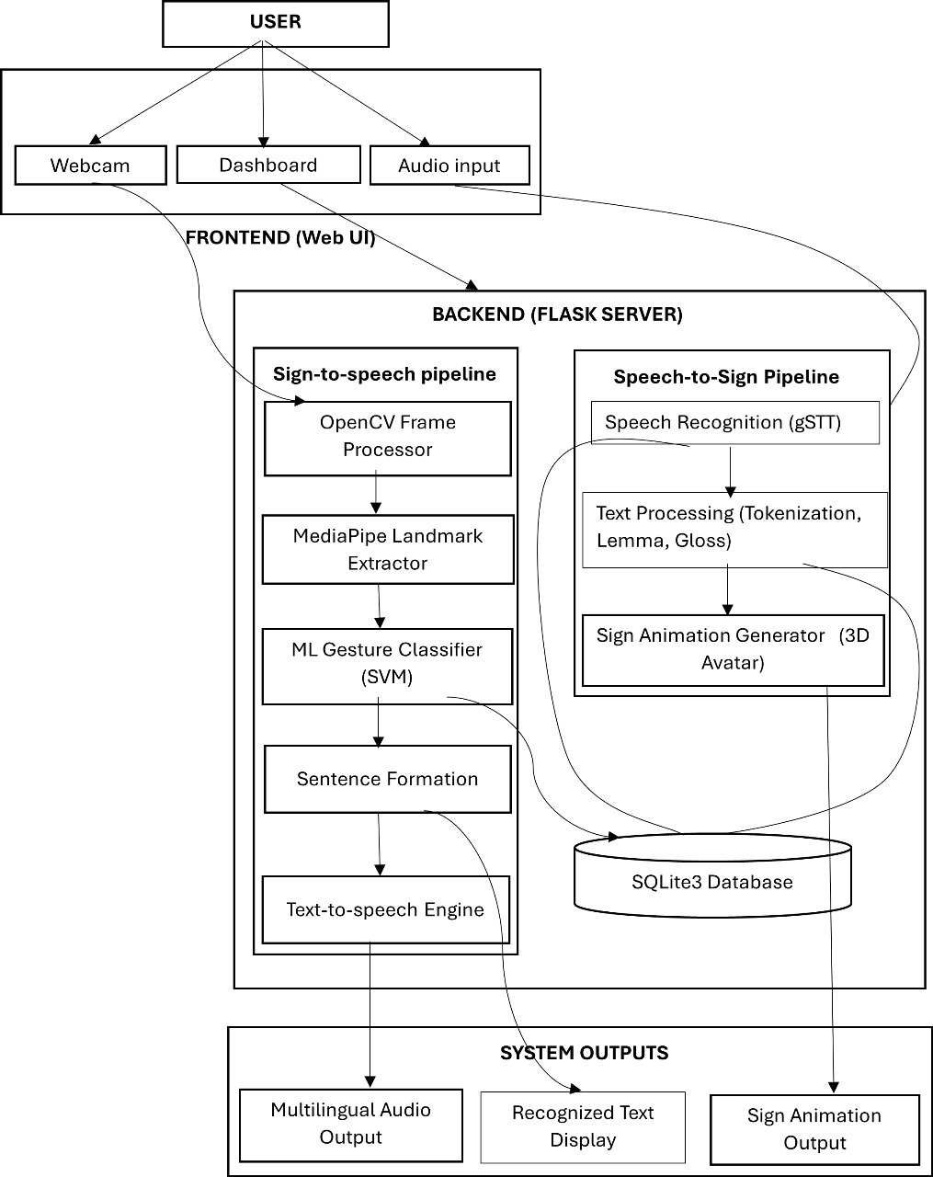
System Architecture
Continuous Sign Language Recognition
Fig 1.1: System Architecture

Slide 10
Sign-to-Speech Implementation Workflow
Continuous Sign Language Recognition
1. Frame Capture & Preprocessing
Webcam video captured using WebUI.
Frames sent to Flask API
OpenCV converts frames.
2. Landmark Extraction
MediaPipe Hand module detects:
  21 hand landmarks per hand
  x, y, z coordinates normalized
Handles variations in lighting, speed, and angles

Slide 11
Continuous Sign Language Recognition
3. Gesture Classification
ML model trained on landmark vectors
Supports:
  Alphabets
  Words
Output → predicted label sequence
4. Sentence Generation & TTS
Gesture sequence → sentence using NLP rules
Converts final text into speech
Multilingual audio output using TTS engine

Slide 12
Speech-to-Sign Animation Implementation
Continuous Sign Language Recognition
1. Speech Recognition Module
Microphone audio recorded in browser
Sent to backend via audio API
Java Speech Recognition API/pysttx3 converts speech → text
Noise filtering improves accuracy
2. Text Processing
Text cleaning: tokenization, stopword removal, lemmatization
Mapping text → sign gloss
Gloss sequence created.

Slide 13
Continuous Sign Language Recognition
3. Sign Animation Generation
Animation engine selects corresponding animations:
  2D GIF-based signs
  3D avatar motion
  Skeletal animation frames
Smooth playback in WebUI using JavaScript canvas or video tag
4. Output Rendering
Animation displayed in real-time
Acts as visual translation for speech input
Dept of CSE(DS),SJBIT

Slide 14
Backend Integration, Model Deployment
Continuous Sign Language Recognition
1. Flask API Endpoints
predict_sign → receives video frame → returns gesture label
convert_speech → STT → gloss mapping
generate_audio → TTS output
login → authentication
Ensures low-latency responses (<300–500 ms)
2. Model Deployment
MediaPipe runs on CPU (lightweight)

Slide 15
Continuous Sign Language Recognition
3. Database (SQLite3)
Stores:
  User accounts + roles
  Sign-to-gloss mappings
  TTS/STT logs
  Animation file paths
  Model configuration
Provides fast local query performance

Slide 16
Testing & Validation
Continuous Sign Language Recognition
1. Testing Approach
Real-time testing with live webcam & microphone
End-to-end workflow validation (Sign→Speech & Speech→Sign)
Evaluation based on accuracy, latency, and usability
2. Types of Testing Performed
Functional Testing:
Sign detection, speech recognition, TTS output, animation rendering, login system.
Unit Testing:
MediaPipe landmark extraction, ML classifier, STT, TTS, animation modules.

Slide 17
Continuous Sign Language Recognition
Integration Testing:
FrameProcessor → LandmarkExtractor →Gesture Classifier
STT → GlossMapper → Animator
Frontend ↔ Flask ↔ DB
Performance Testing:
FPS rate, inference time, response time, TTS latency.
Usability Testing:
User-friendliness, clarity of animations & speech output.
Security Testing:
Authentication, input sanitization, session handling.

Slide 18
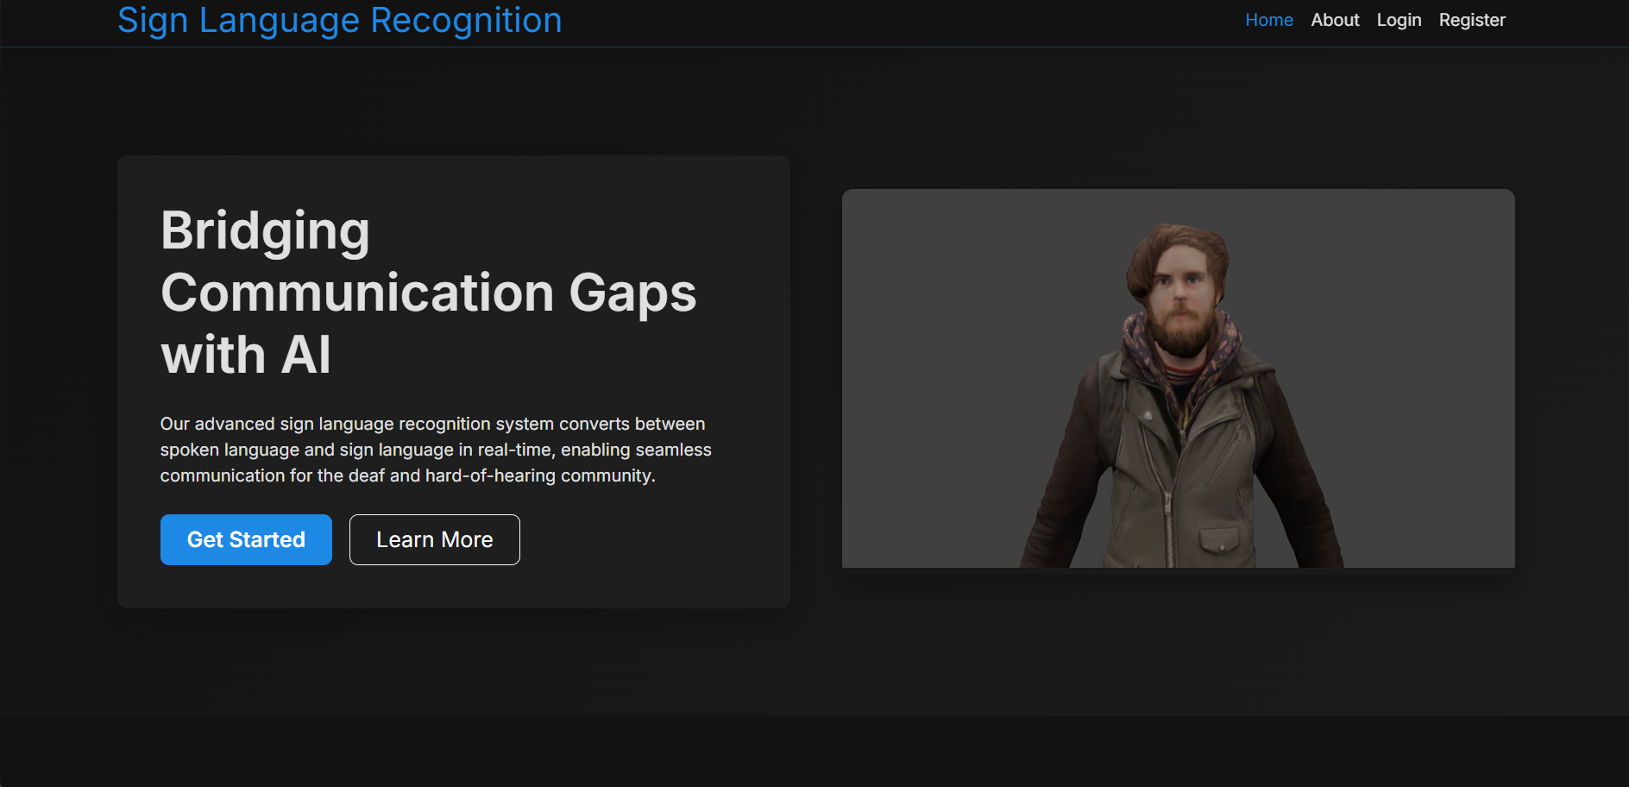
Continuous Sign Language Recognition
Results
Fig 1.2 :Word-to-Sign and Sign-to-Word Web Application Home Screen

Slide 19
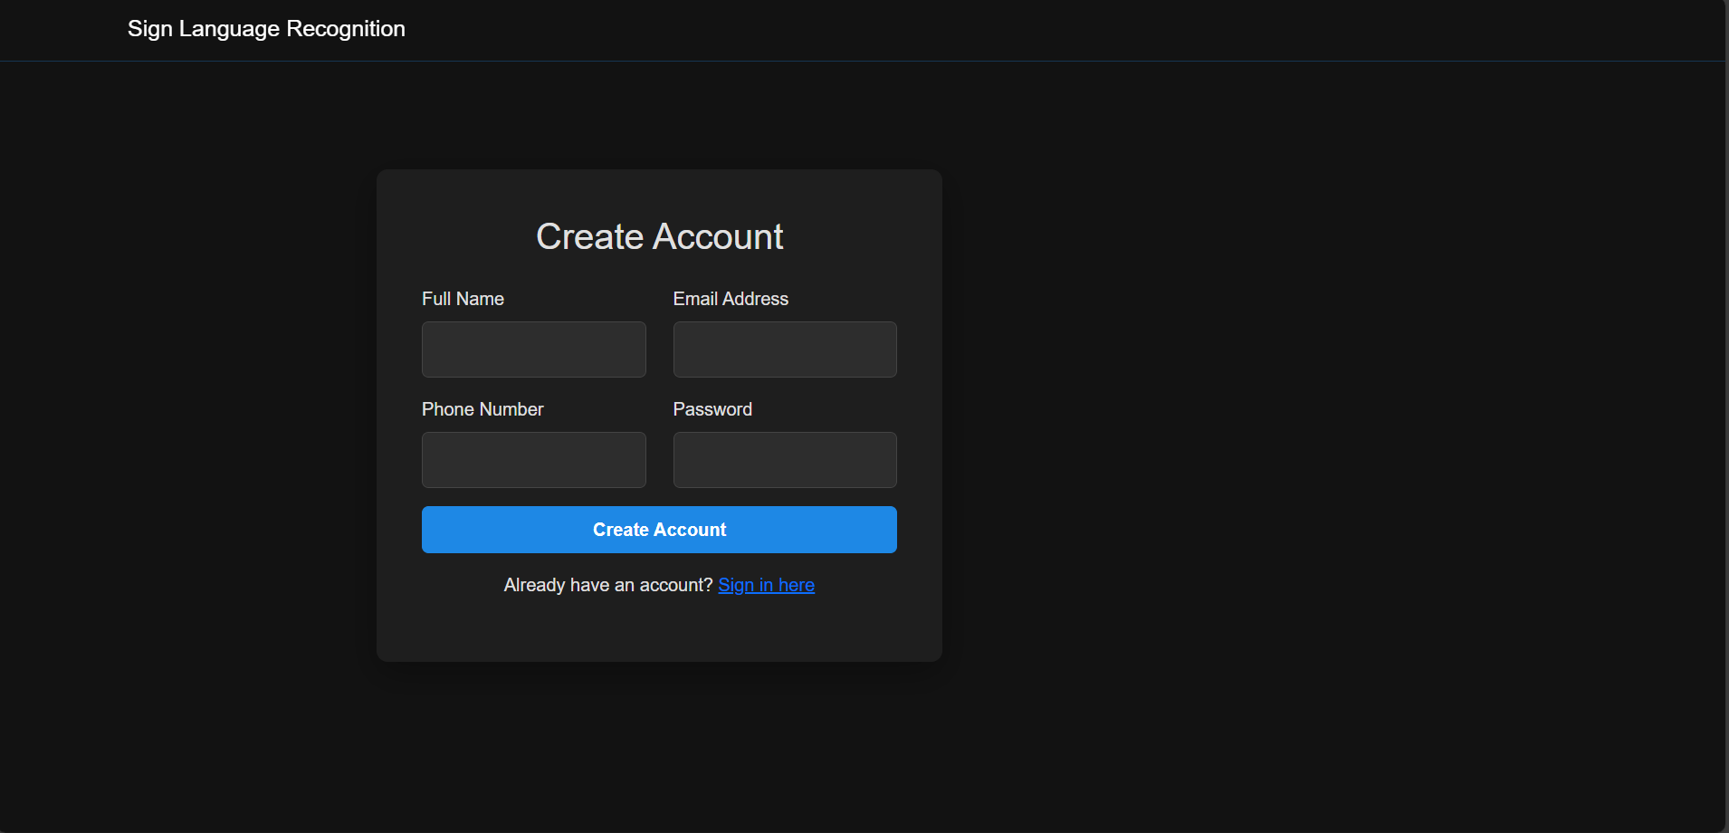
Continuous Sign Language Recognition
Fig 1.3 : User Authentication Interface

Slide 20
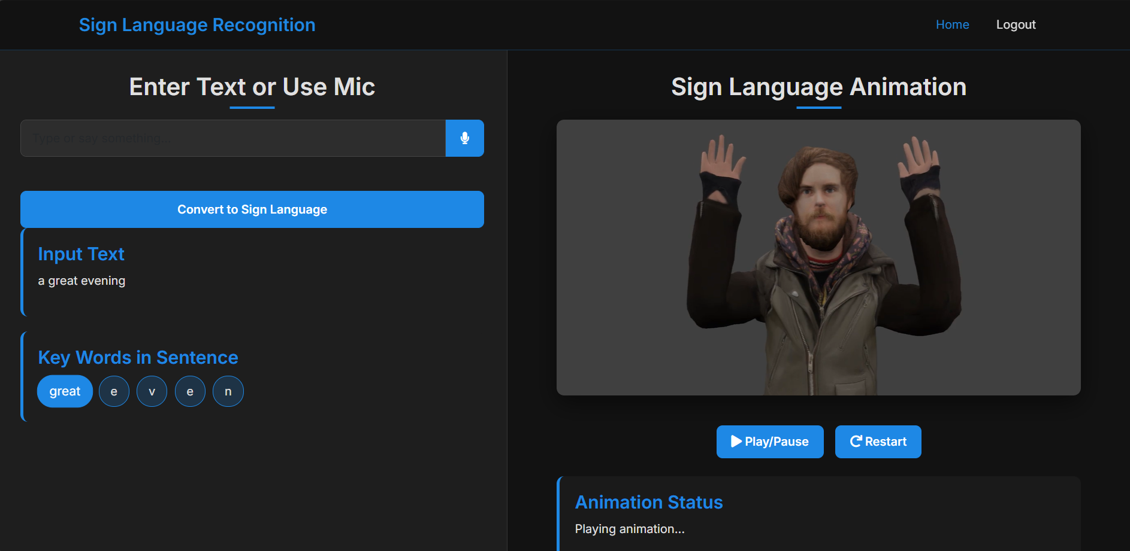
Continuous Sign Language Recognition
Fig 1.4 : Text-to-Sign Animation Output

Slide 21
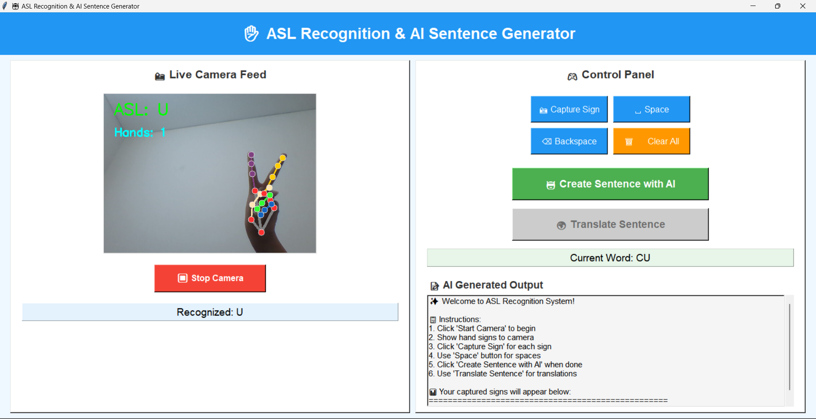
Continuous Sign Language Recognition
Fig 1.5: Real-Time Sign Recognition Output

Slide 22
Conclusion
Continuous Sign Language Recognition
This system enhances accessibility by enabling seamless communication between sign-language users and non-signers. It brings together computer vision, machine learning, speech processing, and web technologies into one unified platform. MediaPipe efficiently extracts hand landmarks, which are then classified by machine-learning models into meaningful gestures, while speech-recognition and animation components enable accurate conversion of spoken input into sign animations. Through this integrated approach, the system supports real-time, bi-directional translation.

Slide 23
References
Continuous Sign Language Recognition
[1] Shanavi Shrivatsava, “CSLR system using deep learning with mediapipe holistic”, Springer, 2024.
[2] R. Rastgoo, K. Sada, and M. Escalera, “Sign Language Recognition: A Deep Survey,” Pattern Recognition Letters, 2021.
[3] Z. Liang et al., “Sign Language Translation: A Survey of Approaches and Datasets,” MDPI Applied Sciences, 2023.
[4] L. Hu et al., “A Speech-driven Sign Language Avatar Animation System,” IJCAI, 2022.
[5] K. M. Rahman et al., “Speak2Sign3D: A Multimodal Pipeline for Speech to 3D Sign Animation,” arXiv, 2025.
[6] A. Kumar et al., “Enhancing Sign Language Detection through MediaPipe and CNN Models,” arXiv, 2024.
[7] S. J. Huang et al., “Sign Language Gloss Translation using Sequence-to-Sequence Models,” IEEE Access, 2021.
[8] P. Singh, “Voice-to-Sign Language Translator Using NLP and Computer Vision,” IJSET, 2024.

Slide 24
THANK YOU
Continuous Sign Language Recognition

